Slide 1
Design Patterns
Claudio Lassala
EPS Software Corp.
claudio@eps-software.com

Slide 2






About me…
Claudio Lassala
claudio@eps-software.com
Blog: ClaudioLassala.spaces.live.com
twitter.com/ClaudioLassala
C# MVP
INETA Speaker
International Speaker and Writer
Software Developer at EPS Software Corp

Slide 3
Session Overview
Introduction to Design Patterns
Introduction to Pattern Catalogs
Several Example Patterns
Factory, Singleton, Façade, Decorator, Hook, Iterator, Mediator, Observer, Strategy, and Template Methods.

Slide 4
Patterns: An Introduction
“Patterns describe a concept or process on an abstract level”
Patterns occur everywhere, not just in object-oriented development
Architectural patterns are popular
There are patterns in publishing and writing
There are patterns in sales
Pick any industry, and you will find patterns…
They are used almost by everyone
Sometimes on purpose
Sometimes subconsciously

Slide 5
OO Design Patterns: An Intro
Many problems in OOP occur over, and over, and over again
Object-Oriented Design Patterns provide standard solutions for these problems

Slide 6
OO Design Patterns: Continued
Patterns…
…provide standard vocabulary
…provide solutions that are known to work
…lead to higher software quality
…result in better code reuse
…provide more maintainability

Slide 7
So, what Patterns are there?
Well… that is a bit hard to say
The list is HUGE and GROWING
There are attempts to form Pattern Catalogs which list the most important ones
Resources
“Head-First Design Patterns”
Agile Principles, Patterns and Practices in C#
“Design Patterns – Elements of Reusable Object-Oriented Software”
http://www.dofactory.com/Patterns/Patterns.aspx
In this talk, I will pick several examples

Slide 8
That’s All Fine, But Do You Have A Practical Example?
Yes!
In fact, we are going to spend the rest of this session on examples
However: This can only be considered a short sampling of available patterns
In fact, we hardly scratch the surface…
Don’t worry about the implementation…
…it’s the concept that counts!
(…did you get the concept?!)

Slide 9
OODP: Factory
Definition: “Provide an Interface for creating families of related or dependent objects”
In Plain English: Have a secondary object create objects in a flexible fashion, rather than using the “new” operator, which produces a very tight coupling
Major Advantage: Flexible configuration without the client needing to have special functionality

Slide 10
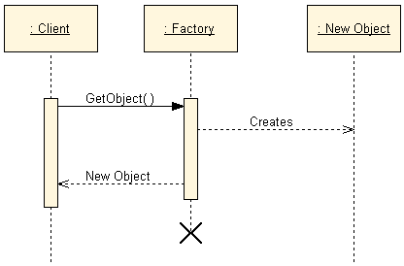
OODP: Factory – Design

Slide 11
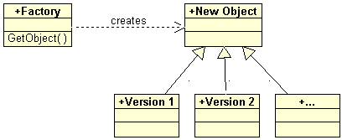
OODP: Factory – Design #1
Single Factory decides what to create
Utilizes possible external configuration

Slide 12
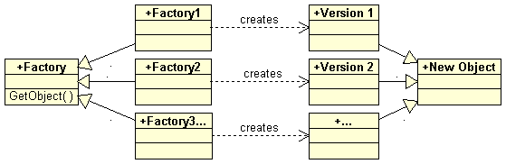
OODP: Factory – Design #2
Different Factory classes are used to create a specific instance of an object
Allows switching entire families of objects

Slide 13

OODP: Factory

Slide 14
OODP: Singleton
Definition: “Ensures a class only has one instance, and provide a global point of access to it”
In Plain English: Often, classes can only have one instance, (such as a User object). This Pattern handles the creation and usage of that object
Major Advantage: Provides a single-instance object (that is easy to use) without the need of global variables and without other major overhead

Slide 15
OODP: Singleton – Design
Singleton class has a private constructor
Therefore, the class can not be instantiated as an object by itself
A single static property or method grants access to the class
Whenever that method/property is accessed, the class checks for an instance that is maintained in an internal, static field
That method/property has access to the private constructor and can therefore instantiate the object

Slide 16
OODP: Singleton

Slide 17
OODP: Façade
Definition: “Provides a unified interface to a set of interfaces in a subsystem”.
In Plain English: A Façade creates a single access object for very complex subsystems.
Major Advantage: Makes complex systems much easier to use.

Slide 18
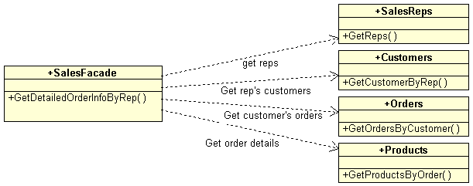
OODP: Façade – Design

Slide 19
OODP: Façade

Slide 20
OODP: Decorator
Definition: “Attach additional responsibilities to an object dynamically. Decorators provide a flexible alternative to subclassing.”
In Plain English: Sometimes you can not subclass, but need to add or modify functionality. With decorators, this can be done by combining two objects.
Major Advantage: Modifies existing objects, even dynamically

Slide 21
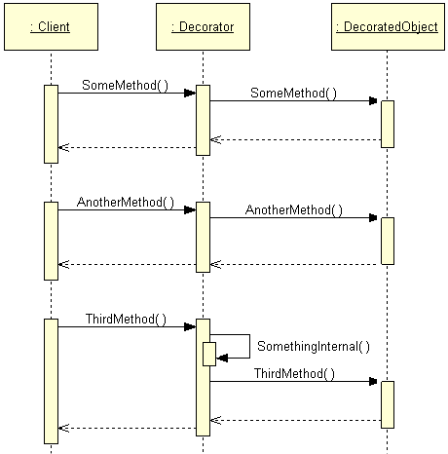
OODP: Decorator – Design

Slide 22
OODP: Decorator

Slide 23
OODP: Proxy
Related to Decorators although it serves a different purpose
Proxy-objects (generally) pose as the “real” object
They often add access rules to a non-secure object
Also used as “on demand” objects
The “real” object only gets instantiated when needed

Slide 24
OODP: Hook (Operation)
Definition: “Defines an extensible class or method that can call additional code through composition.”
In Plain English: Provides a mechanism that allows adding a secondary class or method to an existing object. The object automatically calls code in the secondary object, when it is present.
Major Advantage: Creates a customizable system.

Slide 25
OODP: Hook – Design
A “hookable” object holds a reference to code in an additional method
This could be done using a complete Interface…
…or a simple Delegate
The object checks for the existence of a Hook-object, and if present, calls it
By default, there usually isn’t any behavior attached
Events in VS.NET can be seen as Hooks

Slide 26
OODP: Hook

Slide 27
OODP: Iterator
Definition: “Provides a way to access the elements of an aggregate object sequentially without exposing its underlying representation.”
In Plain English: Allows simple access to member objects (such as items in a collection), one by one.
Major Advantage: Simplified access to complex objects (or collections of objects) without having to be familiar with the inner workings of the obj.

Slide 28

OODP: Iterator – Design
One object has a list of members in some form
A second object (the “Iterator”) has a method that can be called repeatedly to return one member of the list after the other
In VS.NET, this is called an “Enumerator”

Slide 29
OODP: Iterator

Slide 30
OODP: Mediator
Definition: “Defines an object that encapsulates how a set of objects interact. Promotes loose coupling by keeping objects from talking to each other.”
In Plain English: Define a single object that can communicate with other objects, rather than having them communicate directly.
Major Advantages: Removes complexity, and helps maintainability

Slide 31
Mediator – Problem Definition
Whenever objects communicate with each other directly, relationships very quickly grow very complex

Slide 32
Mediator – Problem Definition
Whenever objects communicate with each other directly, relationships very quickly grow very complex

Slide 33
Mediator – Problem Definition
Whenever objects communicate with each other directly, relationships very quickly grow very complex

Slide 34
OODP: Mediator – Solution
A single Mediator object handles all the communication

Slide 35
OODP: Mediator

Slide 36
OODP: Observer
Definition: “Defines a dependency between objects so that when one object changes state, dependent objects can be updated.”
In Plain English: A single object’s sole purpose is to query the state of other objects, and reacts according to state changes
Major Advantage: Can observe changes in objects that are not exposed through events. Can also synchronize objects.

Slide 37
OODP: Observer – Design
A single Observer object has knowledge of other objects
Generally, by storing a reference to them
The Observer actively queries the objects it observes
Could be done using a timer or events
The Observer influences other objects based on the state of the queried objects
Observed objects do not have any knowledge of being observed
This pattern is also known as “Voyeur”

Slide 38
OODP: Observer

Slide 39
OODP: Strategy
Provides interchangeable behavior
Allows for highly customizable software without having to maintain multiple versions of an application
One common process communicates with the chosen strategy objects
All strategy objects implement the same interface

Slide 40
OODP: Strategy - Design

Slide 41
OODP: Strategy

Slide 42
OODP: Template Methods
Definition: “Defines the skeleton of an algorithm in an operation, deferring steps to other methods, possibly in subclasses.”
In Plain English: Rather than putting all the code in a single method, split it into smaller methods, and create one method that does nothing but call the smaller methods.
Major Advantage: Large methods are hard to sub-class, since one can only override or inherit the entire method. Lots of individual methods can be overridden individually.

Slide 43
OODP: Template Methods – Design

Slide 44
OODP: Template Methods

Slide 45
Conclusion
What to expect from Patterns
A common design vocabulary
A learning aid
Simplified documentation
An addition to your “bag of tricks”
Refactoring target

Slide 46

Q&A
claudio@eps-software.com
Blog: ClaudioLassala.spaces.live.com
twitter.com/ClaudioLassala

